Slide 1
Topic 2 – Intro to Data Science
Data Science for Business
Prof: Chris Volinsky
NYU Stern: Fall 2024

Slide 2

What is Data Science?
The science of extracting knowledge and insights from data
“Data science is just statistics with better marketing” - unknown
Stats | Data Science
Distribution focused | Data focused
Focused on models for understanding variable relationships | Focused on algorithms for prediction
Relatively small, clean data sets | Real-world, large, messy data
Used for scientific understanding | Used in business production systems
Starts with hypotheses | Can be exploratory
Obsessed with significance | ¯\_(ツ)_/¯

Slide 3
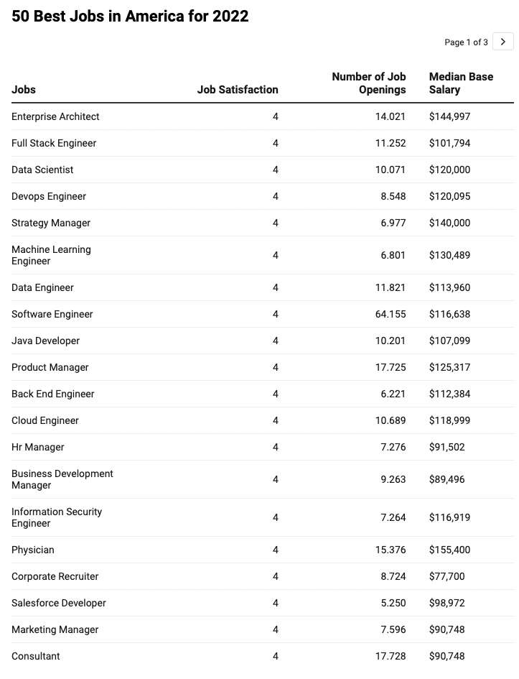
Why Data Science?
Source: Glassdoor

Slide 4

Jobs in Data Science (Technical)
This is a gross oversimplification and many things to argue about…
Job Title | Role
Data Analyst | Understands data, can do some analysis and make reports | Excel!
Data Engineer | Builds, tests and maintains infrastructure for analysis, manages large scale data sets and architectures for modelling | Databases!
ML Engineer | Designs and implements ML learning applications in production | Systems!
Business Intelligence Developer | Business knowledge, assist business clients in quickly finding information through tools and visualizations | Dashboards!
Data Scientist | Advanced analytics, machine learning, and statistical analysis combined with business acumen
Also product manager, consultants,
other DS-adjacent technical positions
Notes:
Book concept: important to understand data science even if you never intend to apply it yourself.
Data is a key asset, and can be a differentiator if used properly
No matter what you do, data literacy is the key : Can you ask intelligent questions? Can you challenge the evaluation?
Product Manager
Interface between tech and business teams, design, represents customer

Slide 5
Data Science Success Stories
Retail & E-Commerce
Amazon: Personalized product recommendations.
Walmart: Supply chain optimization and inventory management.
Banking & Finance
Credit Card Fraud Detection: Using transaction data to identify fraudulent activities.
Signet Bank example [DSB]
Healthcare
Predictive Analytics: Early disease detection and patient care optimization.
Entertainment
Netflix & Spotify: Personalizing viewing and listening experiences.
Sports Analytics
Moneyball (Baseball): Data-driven team assembly and performance strategies.
Notes:
Have them come up with these

Slide 6
Data Science Success Stories
Social Media
Targeted Advertising: Personalized ads based on user interests.
Transportation
Uber & Lyft: Price surge forecasting, optimal routing, driver-passenger matching.
Environmental Monitoring
Climate Change Analysis: Studying weather patterns and environmental impact.
Manufacturing
Predictive Maintenance: Anticipating equipment failures for timely maintenance.
Public Sector
Crime Prevention & Smart Cities: Enhancing urban living and safety
The more data-driven a firm is, the more productive it is
- (Brynjolfsson, Hitt, & Kim, 2011)
Notes:
Data as a competitive advantage and differentiator

Slide 7
Our First Use Case: Nadia / MegaTelCo Churn
Nadia is a Product Manager at MegaTelCo, one of the largest telecommunication firms. MegaTelco is having a major problem with net customer churn in their wireless business, and senior leadership has called in Nadia to lead the solution team. You are the lead data scientist reporting into Nadia.
20% of cell-phone customers leave when their contracts expire
Marketing has designed a special retention offer that might be able to convince customers to stay.
What is the business goal?
What is the specific goal of the data science task/model?
What questions might you have for Nadia?
What will be the output of the the data science exercise? What action will you take?
What data could you collect? On what population?
What are 5 specific features you could collect..
How will you measure success?
Notes:
What is churn? Why is it important?
One basis point = bp = .0001 x 80M = 8000 customers you save with one bp improvement of churn x $100 per month = 800k x 12 = 9.6M
Big Question / Small question
Offer: what is it, how much does it cost, can you give it to everybody, is there a downside to giving it to someone who didn’t need it?
One year, get one month free, 20% of next three months? What is their expectation ?
Output/Goal of model: predict who will take the offer? Why people leave? Who is likely to leave? What training set do you need to collect?
Goal: send marketing a list of who to make the offer to.
How does this action
What is success? 30% take the offer.
Will our action solve the big problrm? Don’t know!!
What comes from the algorithm?
We also need decision logic.
What is the outcome? Who to send the plan to, or who will take the plan, or who will leave?
Or who will be impacted by the plan? These are all different things!
Final question…why not just make the offer to everybody?
MAJOR POINTS / WRAPUP:
Business goal and DS goal are different but need to be aligned
Different parts of the business might have different goals, output/action/evaluation success needs to be aligned to the business problem.
Anything ethical>

Slide 8
Data Science - Process

Slide 9
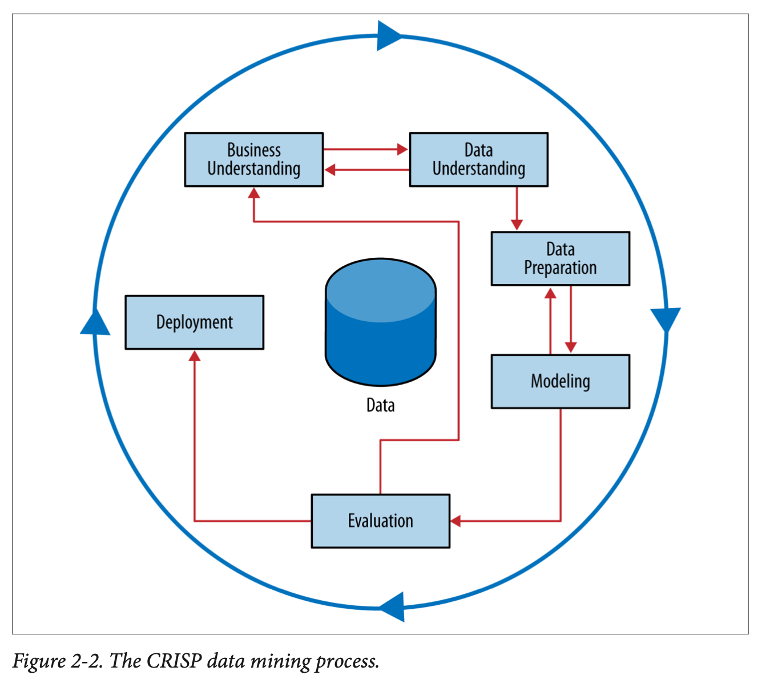
Data Science Process
CRISP-DM =
Cross-Industry Standard Process for Data Mining
Notes:
Work through this on board…
Why a process? Discuss analytics as a craft…this should not be viewed as a formula…more like an “artistic process” – tools, knowledge, experience, common sense.
When to be creative and when to trust the science.

Slide 10
CRISP: Business Understanding

Slide 11


Business Understanding
Data Science should be driven by a key business question
Avoid the “big data pipe dream”
Let’s tell our data scientists to use AI to raise revenue and cut costs!!
Try and break big questions into smaller questions that are answerable by data:
Smaller (answerable) questions:
What are the properties of high performing stores?
Which population segments are buying less?
What strategies reduce customer service hold times?
Big questions:
How do we increase revenue?
How do we diversify customers?
Why is customer satisfaction down?
11
Notes:
11
Problem does not start with data, problem starts with a business need.
Sometimes you do start with a data set and do exploratory work…but that is only typically to do hypothesis generation, and then the questions get more defined
Clustering as an example – customer seg - why do we do it?

Slide 12
Business Understanding
Put the problem into context…ask questions…be creative!
Who are the stakeholders?
Be prepared to ask…
What is the goal of the solution?
Why do we need to do this?
What data is available?
What constraints exist?
What is an acceptable solution?
How do we evaluate?
What does success look like?
Executive
Sales
Marketing
Technology
Operations
Who cares about the outcome?
Who will use it ?
How will they act?
Notes:
Always be prepared to ask lots of questions from your data.
Think about churn…there are different stakeholders with different goals! Who is your client, what is best for the company.
WHAT IS THE ACTION?
Maybe churn isn’t the most important thing?
Maybe biggest cause of churn is poor signal strength / coverage …what can you do?
Lesser cause of churn is bill surprise – but maybe this is more actionable..
There are short term, local goals, and there are longer term needs of the businsess.
You can increase sales by offering 50% discount! Yay! What is wrong with that?
You can decrease churn by offering 3 months free.
people who call customer care every day...why?
Executive team – company strength and perception in marketplace
Sales – increase sales!
Marketing – effectiveness of campaign
Technology – people not leaving due to tech issues
Ops – are we losing customers because we cant onboard them quickly enough?.
These could all be answered from the same data set, or not – but you need to be very clear who your stakeholders are and what the needs of the business are.

Slide 13

Business Understanding
We collect so much great data on our business, can you do some machine learning on it?

Slide 14
CRISP: Data Understanding

Slide 15
Data
We will spend a lot of time talking about data…
Know where your data comes from
Good to have a contact to be able to explain how the data was created
Know how to get the data
What systems, tools, etc
Understand the data
Spend time with EDA (exploratory data analysis)
Know the limits of your data
Need to spend time cleaning the data, caring for it, understanding it
Notes:
HBO Max example – looking at what are the qualities of customers who drop - churn
15k minutes of watching in a week…does this make sense?
There are less than that, but maybe multiple devices…so we figured ok,
But device times out after a certain time…
What does the distribution look like?
Even flat with long tail vs
Distribution with a spike at 15k
Vs one big case at 15k

Slide 16
CRISP: Data Preparation for Modeling
Data Prep involves:
Exploratory Data Analysis
Missing data analysis
Outlier detection and assessment
Feature engineering
Data Munging (ugh.)
We will cover all of this!
Notes:
where most of your time is spent

Slide 17
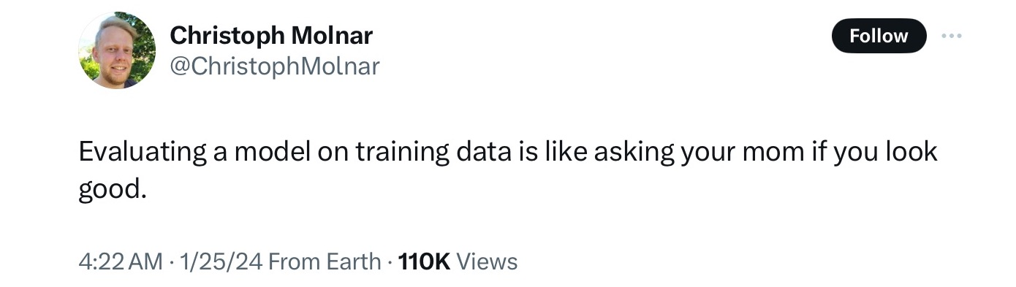
Training and Test sets
This is a core concept in data science / machine learning that separates it from statistics
Why do we need to split data into a training and test sets?
Notes:
Do not want to “memorize” patterns from the training data…
People who live at 50 Olmstead road in Morristown nj like the yankees. That is not actionalble! It is overfitting, it is memorizing.
How does that manifest itself
you can always make the training data look good if you want it to.

Slide 18

Training and Test sets
This is a core concept in data science / machine learning that separates it from statistics
Randomly partition labeled data into training and test set
Training set – data used to train/build the model.
Estimate parameters (e.g., for a linear regression), build decision tree, build artificial network, etc.
Test set – a set of examples not used to fit the model. This gives us a better assessment of the model’s performance – on “unseen” data. Also referred to as out-of-sample data
Generalization Error: Model’s error on the test data.
Comes later…gives a ‘real-world’ sense of how good the model is and if we need to adjust
Original data
Training Data
(80%?)
Test data
(20%?)
deployment examples

Slide 19
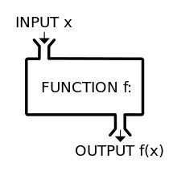
CRISP: Modelling
Modelling
This is the fun stuff!
But it is only meaningful with all of the rest
We will talk a lot about this part!
Notes:
ML – what is it?
Really just a function to take inputs and create outputs. A lot more goes in but that is basic.
Its a function to create a function!

Slide 20
CRISP: Modelling
What data science models (algorithms) do you know?

Slide 21

Statistics v. Data Science
Statistician: the only valid way to test a theory is to come up with a carefully constructed hypothesis and then collect data in a randomized controlled manner so we can correct for all possible confounding variables and assure ourselves of no bias!
Data Scientist: Whatevs! We’ve got lots of data – best prediction wins!!!!
[statistician and data scientist having a polite debate]
Notes:
What are the pros and cons of these takes?

Slide 22
CRISP: Evaluation

Slide 23
Data Process - Evaluation
There are many different ways to evaluate data science model output
What measures of evaluation do you know?
Should always try to interpret the performance in the context of the business problem
Is the success of the model aligned with the business need?
Can you think of an example where a model performs well at its prediction task, but ends up being negative for the firm?
Notes:
What do you know?
RMSE/MAE
Accuracy
ROC curves
(note these are all calculated on already collected data and might be different once deployed)
Does your evaluation metric tie to a business success?
Back to Churn – does the goal of the metric mean we have a valuable model.
Recommender systems…great! I can give people movies they like!
Movie gross…can I predict movie grosses
- short term benefit for long term loss
- benefit to one team but not to the company as a whole
- or a blind spot leads to bias in deployment

Slide 24
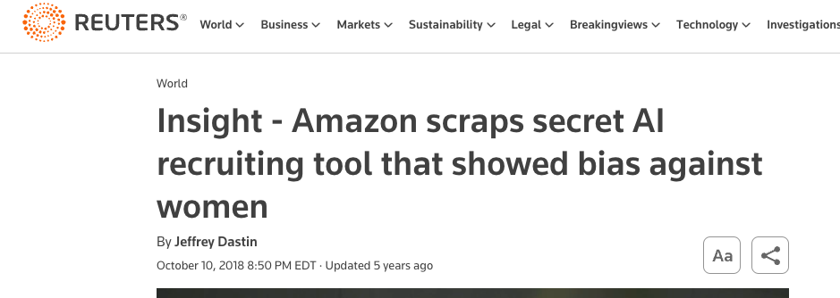
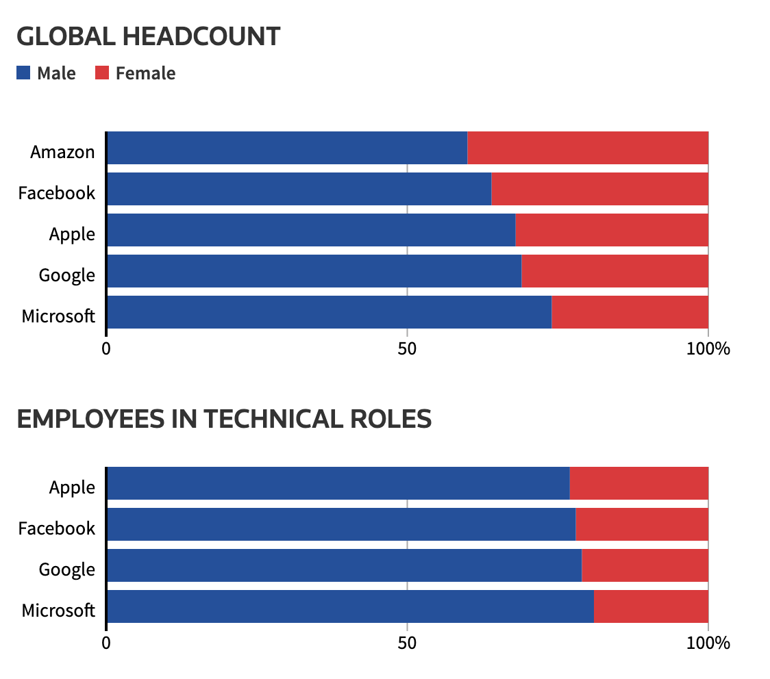
Bias in Machine Learning
Amazon HR hiring tool
“…Amazon's computer models were trained to vet applicants by observing patterns in resumes submitted to the company over a 10-year period. Most came from men, a reflection of male dominance across the tech industry. ”
Other examples of bias??
https://www.reuters.com/article/idUSKCN1MK0AG/
Notes:
Facial Recognition, voice recognition
Algorithms for sentencing (COMPASS)
Credit decisions…
Google Gemini

Slide 25
CRISP: Deployment
How are you going to act on the outcome of your model?
What decisions will be made?
How will the success be measured?

Slide 26

Deployment
Models make predictions – but the business team takes action…
Models don’t have business value until they get into production
Deploy models or scores?
Don’t “boil the ocean”
Pilots
A/B testing
Build monitors into deployment
deploy slowly with feedback loops
Communication between teams is key
[machine learning engineers deploying a model]
DS teams and deployment teams (engineers, DevOps, QA, ..) should be integrated from the start
Notes:
Have them go through what happens when the DS team comes up with a good model…we can improve engagement. Marketing team comes up with a good model, but there are a lot of steps to get approved.
Requires teams to work well together, subject matter expertise on both sides! That is why having a range of knowledge from CS to stat is important!
Typically it is a scoring algorithm that gets deployed
In some cases the ML is deployed in the network – for example new ad campaign can learn who is clicking early, and then automatically find more of those types.

Slide 27
Key Concept
The one most important aspect of every data science project
What action will you take?
Notes:
Making a prediction does not equal action.
What are the consequences of that action?
Will it make a difference, or will it move the needle?

Slide 28
Iterate …
Business Problem
Data
Action
Analysis
Notes:
So many focus on algorithm…but much much more
Must come back to Bus Und!!

Slide 29
Data Science Framework – In Action
Back to Nadia…
Notes:
Think through the steps…big problem, small problem…does solving the small problem impact the big problem?
Data – what are the most important things that might impact churn?
WHAT data would you aslk for – on whom (e.g. only those that left at end of contract?) First Contract?
How do you know who left? What does it mean to cancel?
How far back do you go?
Model – Control data?
what are you training your data on…
Evaluation: what is success? Evaluation before deployment?
What about after deployment? Early stopping?
What is baseline?
How do you turn probabilities into deployed action?
How do you evaluate probabilities? You never observe them? How do you know if it is correct?
Is it just a threshold? what do you do if the customer is high risk but is already under contract? what if a customer is low risk but very valuable?

Slide 30
Data Science – terminology

Slide 31
Taxonomy of Data Science tasks
Predictive
Descriptive
I would like to make predictions about cases that I have not seen yet
I would like to understand the data to tell stories and help me comprehend more about a topic or situation
Examples
Most data science algorithms
Decision Trees
SVM (Support Vector Machines)
Neural Nets / Deep Learning
Reinforcement Learning
Examples:
Data Visualization
Clustering
Segmentation
Association Rules
Notes:
mention inferential as well?
also point out predictive is really best for their projects!!

Slide 32
Taxonomy of Data Science tasks
Supervised
Unsupervised
There is a specific, quantifiable target that we are interested in or trying to predict
There is no such target, we are just trying to understand the data
Predictions!
Patterns!
Lets predict whether a customer will buy our product based on her browsing habits of our website!
Lets segment our customer base into clusters that will help us define broad persona-based marketing strategies
Notes:
Another way of saying the same thing
Note – can add re-inforcement mearning here. You update the model as you get input/

Slide 33
Supervised Learning
Supervised
Classification
Regression
Time series
Other…
Prediction variable is categorical (perhaps binary)
Prediction variable is numeric - continuous
Data are time-based: forecasting into future
Predicting text or media…
Will the loan applicant default on their loan?
How much money will this customer spend on my product next year?
What will the DJIA close at next month?
What should my customer care chatbot say next?
Not cut and dried…tasks can fall between categories
Notes:
Multi factor could be like a customer segmentation model:
Hi value -
Lo value
Frequent purchaser
Don’t take this too seriously
sometimes you need to do both classification and regression...
or time series and regression
New product…will they buy the product, how much will they spend IF they buy the product.

Slide 34
Example
Loan Applicants – goal is to build a model to assess what factors result in loan default
Data:
Name | Industry | Age | Date | Balance | Default
Mike | Finance | 30 | 02/13/04 | 123,000 | Yes
Mary | Medical | 40 | 29/06/13 | 51,100 | Yes
Bill | Construction | 55 | 14/08/09 | 68,000 | No
Jim | Medical | 46 | 01/01/07 | 74,000 | No
Mark | Finance | 47 | 23/12/11 | 23,000 | Yes
Anne | Finance | 49 | 19/0512 | 100,000 | No
Supervised or unsupervised?
Classification or regression?
What action might we take??
Notes:
Action…don’t accept the loan!
Q: what is the action that they might take?
What is the outcome of the model?
What is the action of the model?
Put the model in the hands of the loan officer, who can make a judgement…

Slide 35
Supervised example
Loan Applicants – goal is to build a model to assess what factors result in loan default
Data:
Variables
Attributes
Features
Independent Variables
Predictors
Target
Dependent Variable
Identifier
Name | Industry | Age | Date | Balance | Default
Mike | Finance | 30 | 02/13/04 | 123,000 | Yes
Mary | Medical | 40 | 29/06/13 | 51,100 | Yes
Bill | Construction | 55 | 14/08/09 | 68,000 | No
Jim | Medical | 46 | 01/01/07 | 74,000 | No
Mark | Finance | 47 | 23/12/11 | 23,000 | Yes
Anne | Finance | 49 | 19/0512 | 100,000 | No
Observations
Instances
Data Points
Examples
X
Y

Slide 36
Model
Model: a method or algorithm used to generalize a pattern or make a prediction from a set of examples
Name | Industry | Age | Date | Balance | Default
Mike | Finance | 30 | 02/13/04 | 123,000 | Yes
Mary | Medical | 40 | 29/06/13 | 51,100 | Yes
Bill | Construction | 55 | 14/08/09 | 68,000 | No
Jim | Medical | 46 | 01/01/07 | 74,000 | No
Mark | Finance | 47 | 23/12/11 | 23,000 | Yes
Anne | Finance | 49 | 19/0512 | 100,000 | No
Algorithm:
Induces a function
from examples
Classification Model:
If Balance >= 50K and Age > 45
Then Default = ‘no’
Else Default = ‘yes’

Slide 37
Supervised Models
A model can be any function that takes inputs and makes a predictive output
Name | Age | Balance | Default
Mike | 30 | 123,000 | Yes
Mary | 40 | 51,100 | Yes
Bill | 55 | 68,000 | No
Jim | 46 | 74,000 | No
Mark | 47 | 23,000 | Yes
Anne | 49 | 100,000 | No
If Names starts with M
Then Default = ‘yes’
Else Default = ‘no’
Age is inversely proportional
to default
The model allows you to make predictions for cases you have not seen before (assuming the same data attributes)
If Balance >= 50K and Age > 45
Then Default = ‘no’
Else Default = ‘yes’
Notes:
Can they come up with them?

Slide 38
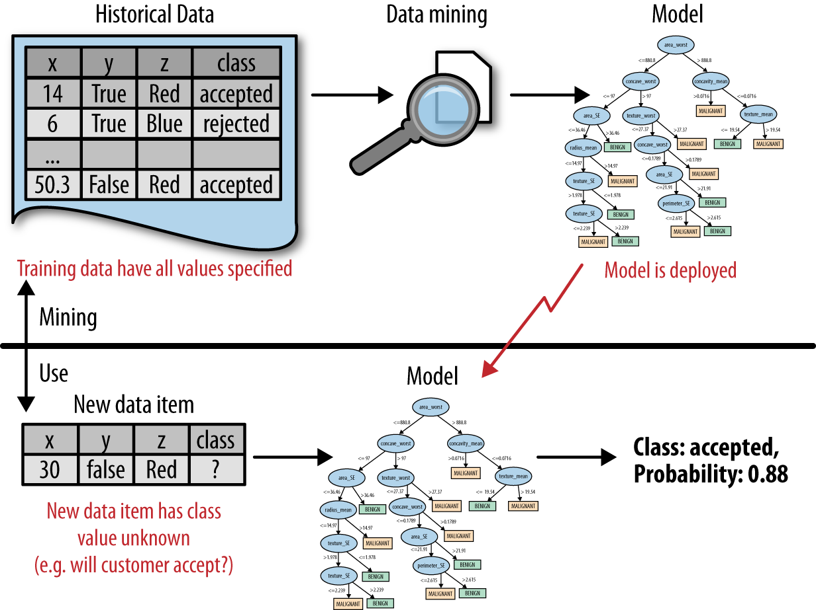
Back to the process …
DSB Fig2-1
Predictive analytics flow
data science / Learning / Training the model
Prediction
Decision/Action
“Send offer”
Using the model
Notes:
Put on board as data science vs use (deployment)
Data – science – selected mdlel
========================
New data – model – prediction – action (--outcome--feedback)
ML is a pogram that writes programs

